Slide 1
Regression Splines
Team 1
Ignacio G., Liuba H., Sarah M., Michael S.

Slide 2
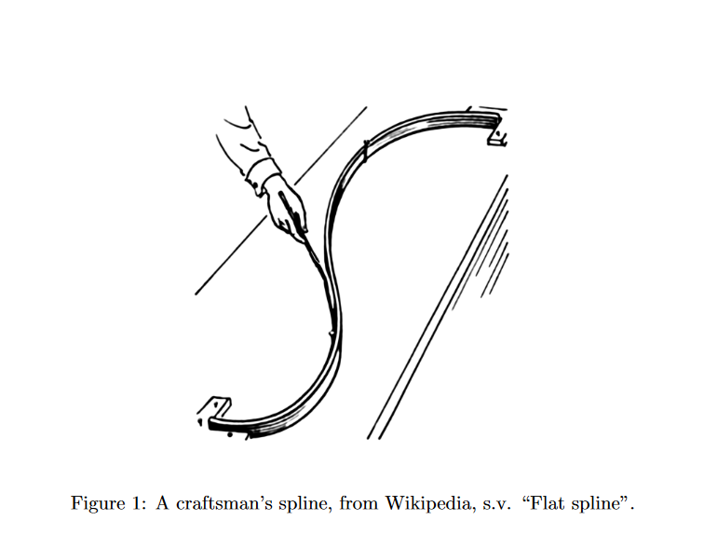
Agenda:
Splines: Basic Idea
Basis Representation
Choosing the Number of Knots
Comparison to Polynomial Regression
R Example and Practice
Notes:
http://proquest.safaribooksonline.com/book/math-and-science/9781118591635/chapter-13-bayesian-penalized-spline-models-for-statistical-process-monitoring/c13_sec1_0002_htm?query=((regression+splines))#snippet
https://www.whitman.edu/Documents/Academics/Mathematics/Griggs.pdf

Slide 3

Behind Regression Splines: Piecewise Polynomials
Piecewise polynomial functions: use different functions for different areas of the x-axis
Function changes at an area called a knot.
More knots = more flexibility
Common kind is cubic, but can use any polynomial
A cubic piecewise with 1 knot has 8 DOF, 4 for each eq.

Slide 4
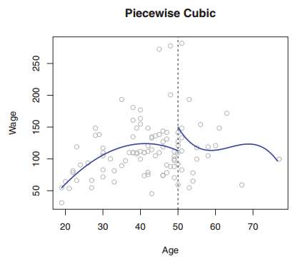
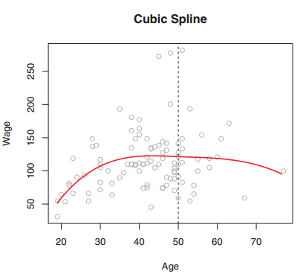
Adding Constraints: Creating Splines
Piecewise functions disjointed, not smooth
Fix by adding constraint that they must be continuous at knots
Make smoother (into cubic spline) with constraints of first and second derivatives being continuous at knots
Each continuity constraint reduces DOF by 1, so the cubic spline to the right has 5 DOF.

Slide 5
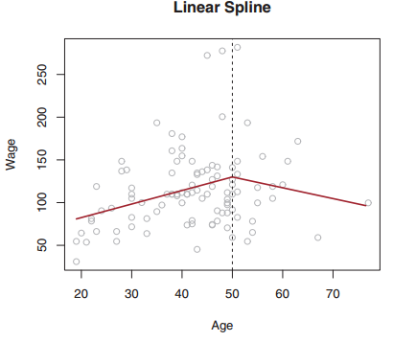
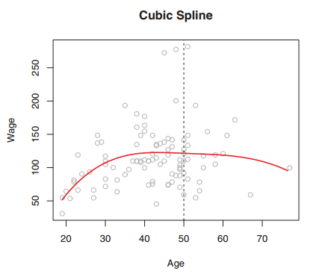
Types of Splines
Spline definition:
A piecewise function with continuous derivatives up to degree d-1 at each knot, where d is the degree of the spline.
Splines can be of any degree, including linear. However, cubic splines are the most popular, due to their balance of flexibility and low degree.

Slide 6


Mini Quiz
A model of the form
where c1< c2 is an example of a piecewise polynomial (degree = 3) with knots and uses degrees of freedom.
Answer:
Cubic, 2, 12

Slide 7

Mini Quiz
Write an example of a quintic
piecewise polynomial with one knot.
How many DOF does it have?
Answer:
12 DOF

Slide 8
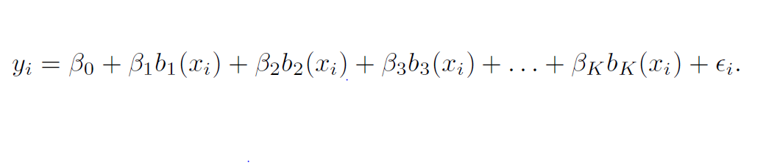
The Spline Basis Representation
How can we fit a piecewise degree-d polynomial under the constraint that it (and possibly its first d − 1 derivatives) be continuous?
We can use the basis model to represent regression splines!
Notes:
Example on the board: Cubic Spline with one knot K=1

Slide 9
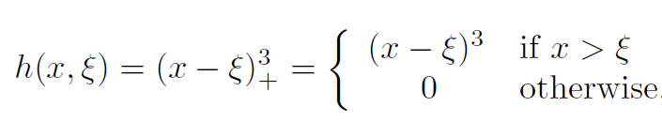
Basis Representation of Cubic Splines
A cubic spline with K knots can be represented as:
The model can then be fit using least squares
There are many ways to represent cubic splines but the most direct way is to use truncated power functions:
Estimate K + 4 regression coefficients with K + 4 degrees of freedom

Slide 10
Mini Quiz
Write the basis model for a cubic spline with knots at x = 5 and x=10 where h(x_{i ,}ξ) is a truncated power function
Answer:
y_{i} = β₀ + β₁x_{i} + β₂x_{i}² + β₃x_{i} ³ + β₄h(x_{i} , 5) + β₅h(x_{i} , 10) + ε_{i}

Slide 11
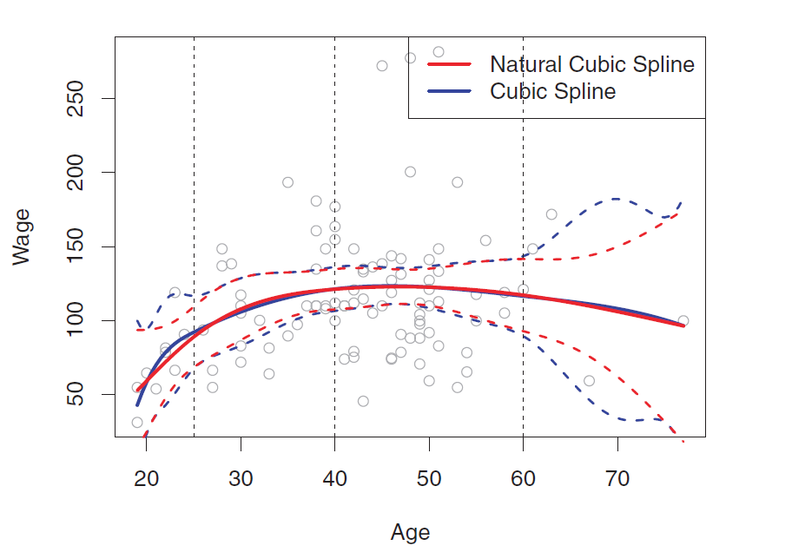
Natural Splines

Slide 12
Choosing the Number and Locations of the Knots
Most flexible in regions that contain a lot of knots
Polynomial coefficients can change rapidly
One option is to place knots uniformly.
To choose the number of knots
you can see what looks best
or use Cross Validation.

Slide 13
Comparison to polynomial regression
Notes:
Before start talking about Comparison Splines to Polynomial Regression I would like to go over a quick example that will help to understand why splines in some cases better for modeling than polynomial regression.

Slide 14

Example
Titanium heat data has 49 observations expressing a thermal property of titanium (this data set commonly used for splines with free knots example). Data has two columns: physical property (y) and temperature (x).
Model predicting titanium physical property (y) using a single predictor temperature (x)
Notes:
Here is our example:
We have a Titanium heat data with 49 obs that expression a thermal property of titanium.
……..
Data has two columns
We are trying to build a model prediction titanium physical property (g) using a single predictor temperature.

Slide 15
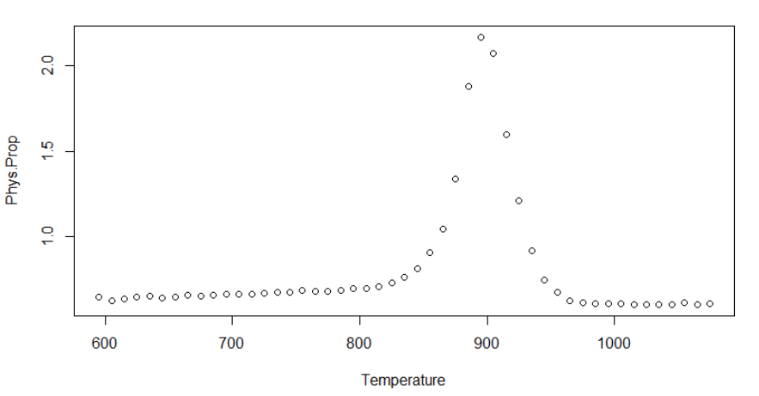
Example (Cont’d)
The scatter plot of the Temperature and Physical Property of Titanium. It reveals a nonlinear relationship between them.
Notes:
At first we want to graph the data
The scatter plot displays relationship between our variables …….

Slide 16
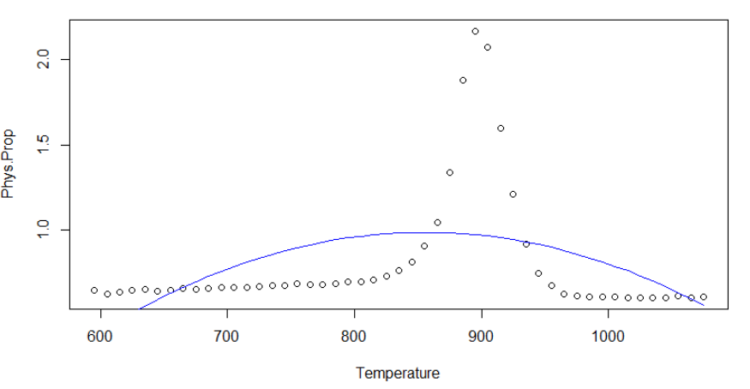
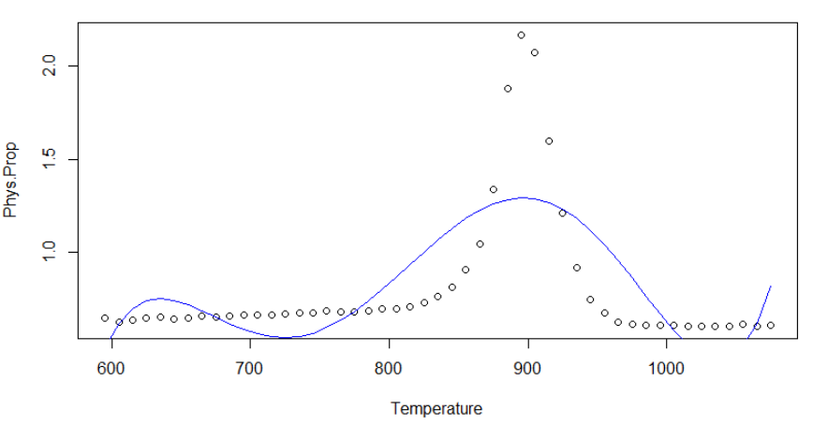
Example (Cont’d)
Quadratic Fit:
titanium.lm2 <- lm(g ̃poly(temperature,2))
Top Graph: Blue curve displays the fitted value from a least squares quadratic regression polynomial
5th Order Fit:
titanium.lm5 <- lm(g ̃poly(temperature,5))
Bottom Graph: Blue curve displays the fitted value from a least squares 5th degree regression polynomial
Notes:
We immediately see the problem, pretty miserable fit. Does a higher polynomial fit better?
At first we are building a model with quadratic fit

Slide 17
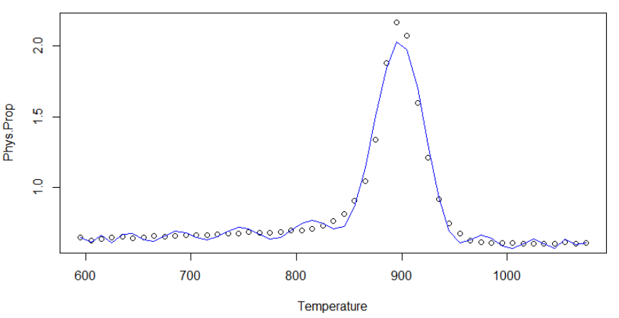
Example (Cont’d)
21st Order Fit:
titanium.lm21 <- lm(g ̃poly(temperature,21))
Top Graph: Blue curve displays the fitted value from a least squares 21st degree regression polynomial
Notes:
This model would not be the best solution for this data set

Slide 18
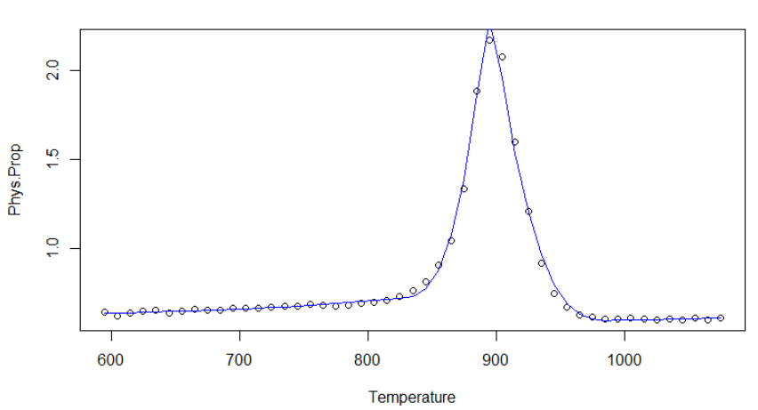
Example (Cont’d)
Cubic Spline:
titanium.spline<- glm(y~ns(x, knots=c(825, 885, 895, 905, 990)))
Notes:
We are fitting cubic spline

Slide 19
Example (Cont’d)
Why not polynomials?
Polynomial curve, degree greater than 5, can become overly flexible and can take on very strange shapes
It is unusual to use greater than 3- or 4-degree polynomials
Keep order of the model low to avoid overfitting
Notes:
Lets summarize our observation and answer the question - Why not polynomials?

Slide 20
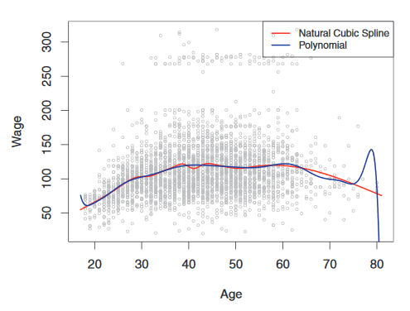
Comparison to polynomial regression
Splines introduce flexibility by increasing the number of knots while keeping the degree of polynomials fixed
Extra flexibility in the polynomials produces undesirable results at the boundaries, while the natural cubic spline provides a reasonable fit for the data
Notes:
I would like to go over the

Slide 21
Comparison to polynomial regression
Splines produce more stable estimates
Splines allow you to place more knots over regions where function F seems to be changing rapidly, and fewer knots where the function f appears more stable
Larger k – equally distanced knots:
Gives us more precision
Smaller errors
Prone to overfitting

Slide 22
Mini Quiz
Name a reason to use splines instead of a high-degree polynomial
Answer:
Splines allow you to place the knots/choose where it’ll be most flexible
Especially useful for boundaries where polynomials tend to go crazy
Notes:
And now its time for question to the class:
From example mentioned earlier and from previous slides please Name ….

Slide 23
R Example and Practice

Slide 24
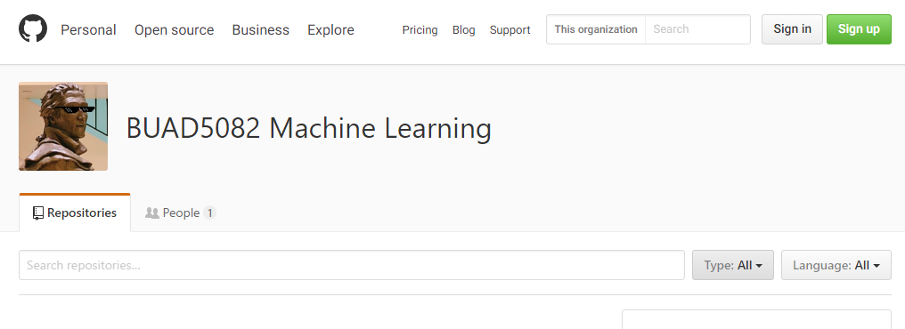
Example in R
Lab 7.8.2

Slide 25
Mini Quiz
What library is required for using splines?
Answer:
splines
Notes:
And now its time for question to the class:
From example mentioned earlier and from previous slides please Name ….

Slide 26
Mini Quiz
Which function generates the basis functions for splines?
Answer:
bs()
Notes:
And now its time for question to the class:
From example mentioned earlier and from previous slides please Name ….

Slide 27
Mini Quiz
What splines are produced by default?
Answer:
cubic
Notes:
And now its time for question to the class:
From example mentioned earlier and from previous slides please Name ….

Slide 28
Mini Quiz
Which function do you use to fit natural splines?
Answer:
ns()
Notes:
And now its time for question to the class:
From example mentioned earlier and from previous slides please Name ….

Slide 29
Mini Quiz
Why do we still use lm or glm?
Answer:
Because we’re still doing a linear model with least squares regression, just split into pieces.
Notes:
And now its time for question to the class:
From example mentioned earlier and from previous slides please Name ….

Slide 30
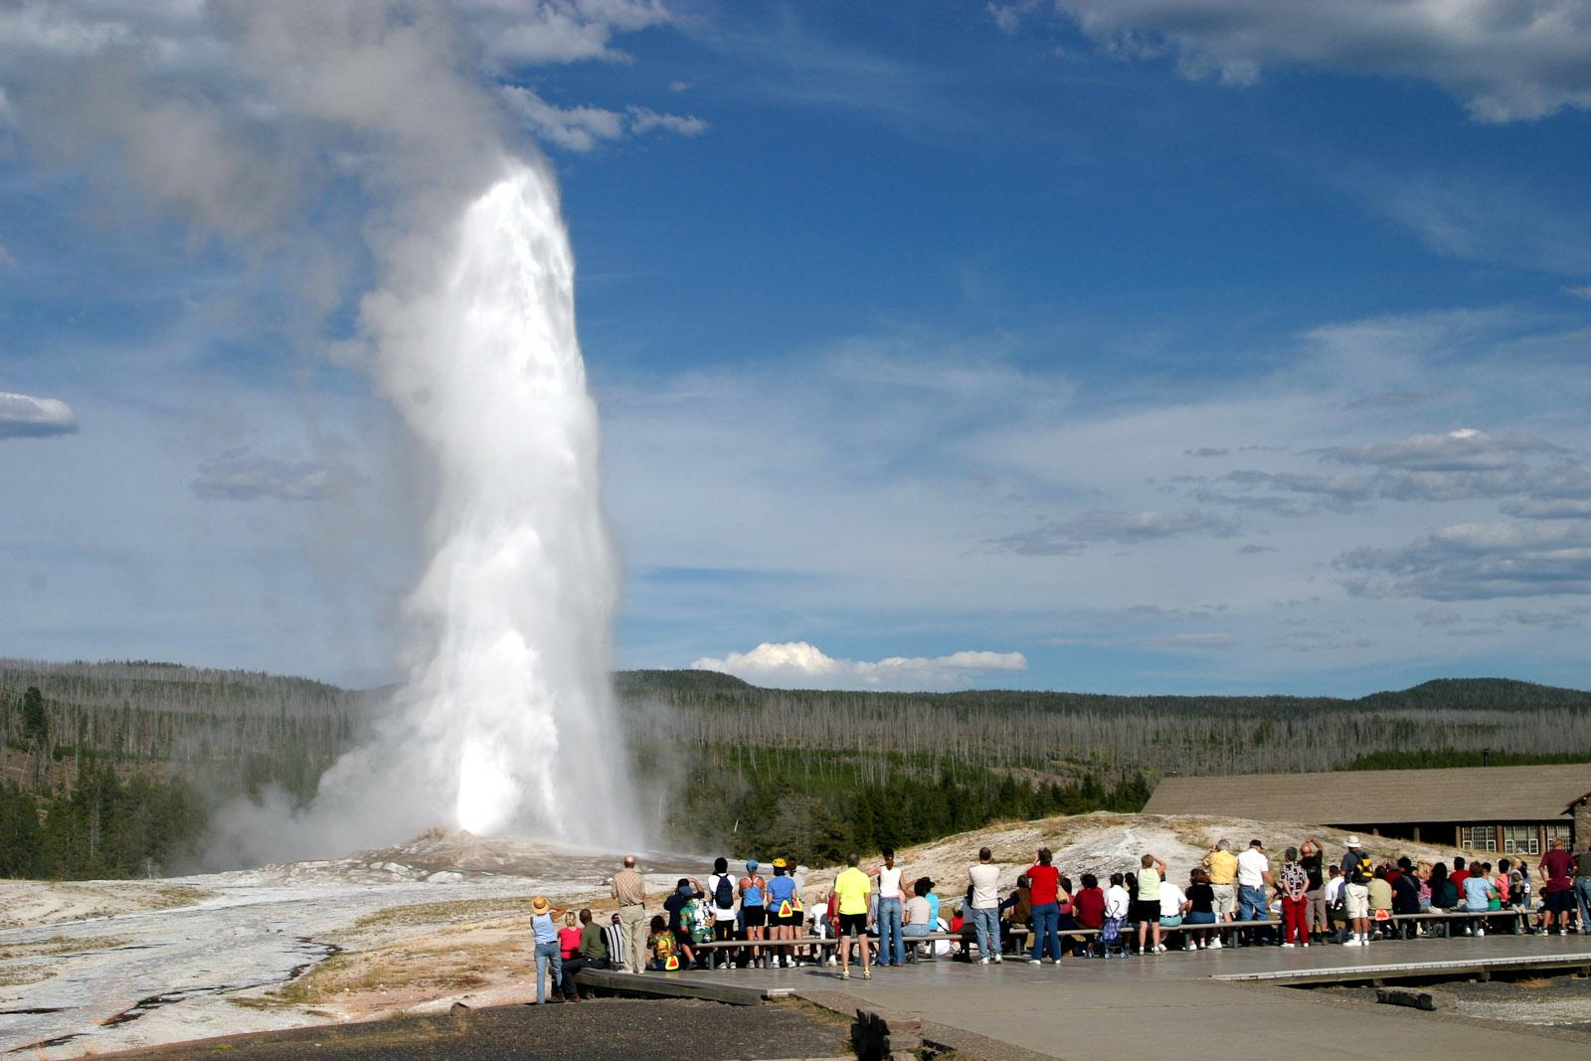
Y: waiting time until the next eruption
X: previous eruption duration (minutes)
Notes:
http://www.r-tutor.com/elementary-statistics/quantitative-data/scatter-plot

Slide 31
Questions?

